Slide 1
Divide and Conquer Technique
Week-3
DSA-II Lab

Slide 2
Find Maximum and Minimum
The Divide-and-Conquer algorithm:
procedure Rmaxmin (i, j, fmax, fmin); // i, j are index #, fmax,
begin // fmin are output parameters
case:
i = j: fmax ← fmin ← A[i];
i = j –1: if A[i] < A[j] then fmax ← A[j];
fmin ← A[i];
else fmax ← A[i];
fmin ← A[j];
else: mid ← (i + j)/2;
call Rmaxmin (i, mid, gmax, gmin);
call Rmaxmin (mid+1, j, hmax, hmin);
fmax ← MAX (gmax, hmax);
fmin ← MIN (gmin, hmin);
end
end;

Slide 3
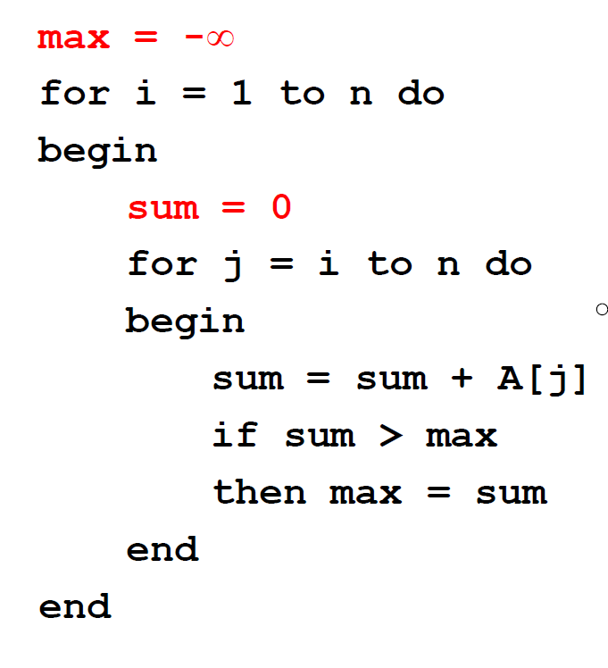
Find Maximum Subarray
Brute Force Approach

Slide 4
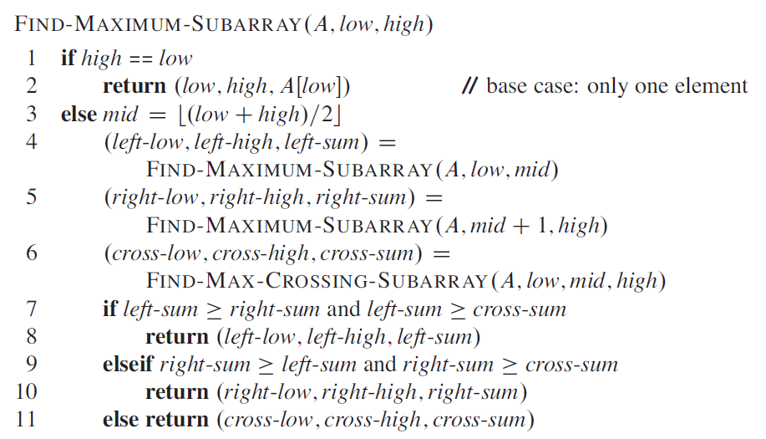
Find Maximum Subarray

Slide 5
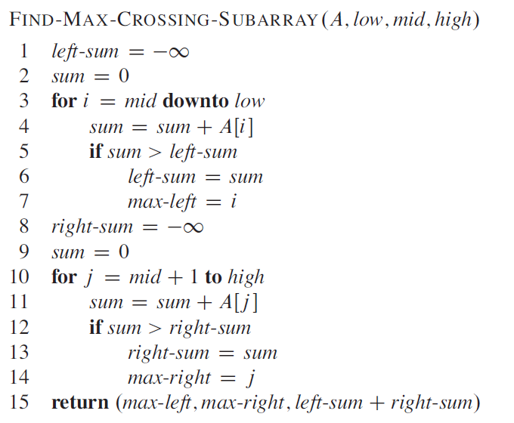
Find Maximum Subarray

Slide 6
Practices(Solve using divide and conquer technique)
Count total even numbers in an array using divide and conquer technique.
Count total vowels in a string using divide and conquer technique.
Find the largest pair in a given array.
Given an array of size n, return the majority element.The majority element is the element that appears more than ⌊n/2⌋ times. You may assume that the majority element always exists in the array.
You are given a list of students who have name, id and cgpa. Your task is to find the student with highest cgpa. [ you can’t sort the list]
Find second maximum and second minimum element in a given array.

Slide 7
Practices(Solve using divide and conquer technique)
6. Given an integer array nums, count the number of smaller elements to the right of nums[i].
Example 1:
Input: nums = [5,2,6,1]
Output: [2,1,1,0]
Explanation: To the right of 5 there are 2 smaller elements (2 and 1). To the right of 2 there is only 1 smaller element (1). To the right of 6 there is 1 smaller element (1). To the right of 1 there is 0 smaller element.
Example 2:
Input: nums = [-1] Output: [0]

